Slide 1

BELLMAN’S EQUATION
CONTENTS:
Importance of Bellman’s Equation
Important terms (Discounted Return, V-function and Q-function)
Bellman’s Equation
Derivation
Sample Program

Slide 2
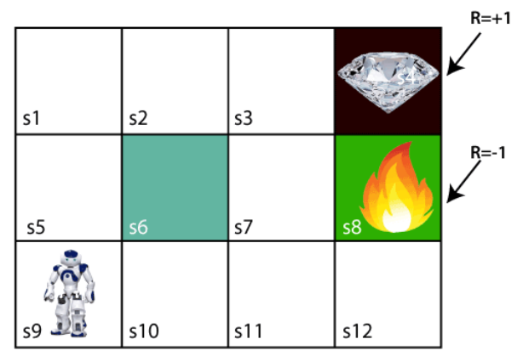
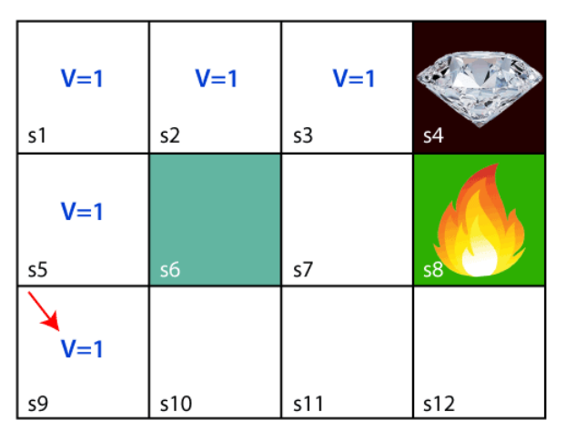
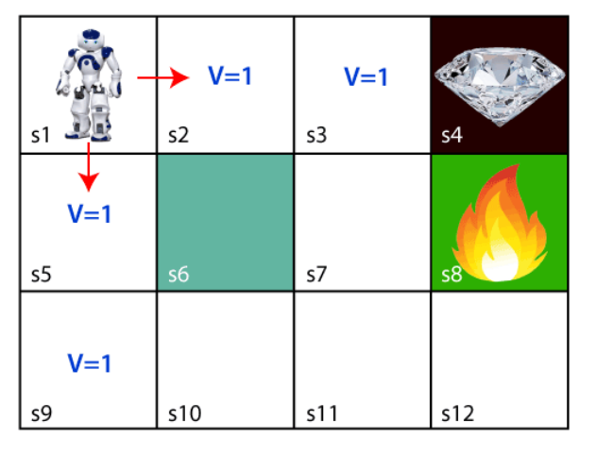
IMPORTANCE OF BELLMAN’S EQUATION

Slide 3

DISCOUNTED RETURN ($G_{t}$)
Definition: It is the total long term discounted reward from time step t.
$$G_{t}=R_{t+1}+{γR}_{t+2}+{γ^{2}R}_{t+3}. . . . . =\sum_{j=0}^{T}{γ^{j}R_{t+j+1}}$$
$G_{t}=R_{t+1}+γ(R_{t+2}+$ ${γR}_{t+3}+γ^{2}R_{t+4}+. . . . . +γ^{T−1}R_{T})$
$$G_{t}=R_{t+1}+γ(G_{t+1})$$
Discount factor $(γ)$ $∈\left[0,1\right]$
γ=0: the Agent is only interested in the immediate reward and discards the long-term return.
γ=1: the Agent will consider all future rewards equal to the immediate reward.

Slide 4
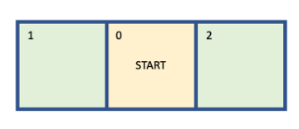
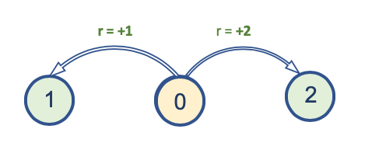

V-FUNCTION(State-value function)
In a formal way the value $V_{π}\left(s\right)$, is:
$$V_{π}\left(s\right)=𝔼_{π}\left[G_{t} | s=s_{t}\right]=𝔼_{π}[\sum_{j=0}^{T}{γ^{j}R_{t+j+1}}|s=s_{t}]$$
Always left: V(0) = 1x1 = 1
Always right: V(0) = 1x2 = 2
Take left with 0.5 and take right with 0.5:
V(0) = 0.5x1 + 0.5x2 = 1.5
4. Take left with 0.2 and take right with 0.8:
V(0) = 0.2x1 + 0.8x2 = 1.8
Best Policy would be option 1 “always right”

Slide 5
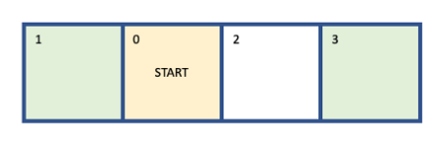
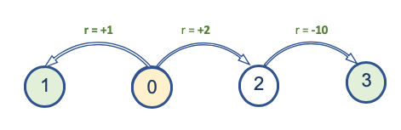
Always left: V(0) = 1x1 = 1
Always right: V(0) = 1x(2+(-10))= -8
Take left with 0.5 and take right with 0.5:
V(0) = 0.5x1 + 0.5x(2+(-10))= -3.5
4. Take left with 0.2 and take right with 0.8:
V(0) = 0.2x1 + 0.8x(2+(-10)) = -6.2
Best Policy would be option 1 “always left”

Slide 6
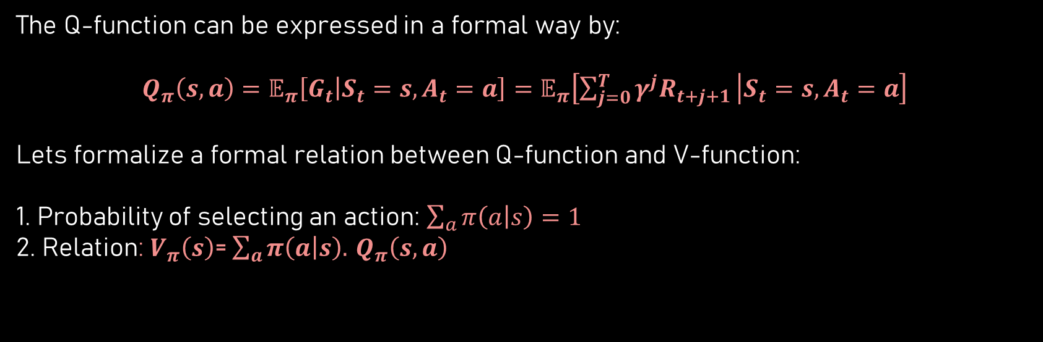
Q-FUNCTION (Action-value function)
The Q-function can be expressed in a formal way by:
$$Q_{π}\left(s,a\right)=𝔼_{π}\left[G_{t} | S_{t}=s,A_{t}=a\right]=𝔼_{π}\left[\sum_{j=0}^{T}{γ^{j}R_{t+j+1}} | S_{t}=s,A_{t}=a\right]$$
Lets formalize a formal relation between Q-function and V-function:
1. Probability of selecting an action: $\sum_{a}{π\left(a | s\right)=1}$
2. Relation:$V_{π}\left(s\right)$= $\sum_{a}{π\left(a | s\right).}$ $Q_{π}\left(s,a\right)$

Slide 7

BELLMAN’S EQUATION
The Bellman equation decomposes the value function into two parts, the immediate reward plus the discounted future values.
Why is it needed?
Bellman’s Equation:
$V_{π}\left(s\right)$= $\sum_{a}{π\left(a | s\right).}\sum_{s′}{P_{ss^{′}}^{a}(r\left(s,a\right)+γV_{π}\left(s′\right))}$
Here,
$r\left(s,a\right)$: immediate reward
$γV_{π}\left(s′\right)$: discounted future rewards

Slide 8
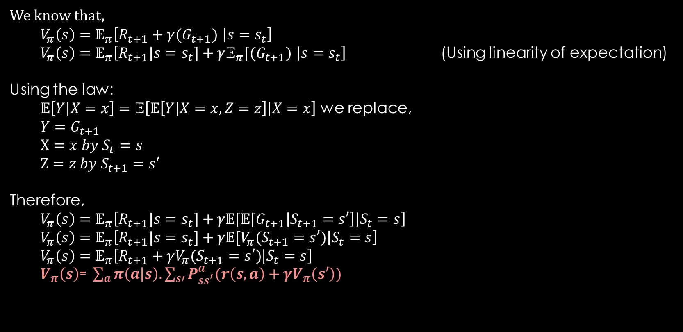
DERIVATION
We know that,
$V_{π}\left(s\right)=𝔼_{π}\left[R_{t+1}+γ(G_{t+1}) | s=s_{t}\right]$
$V_{π}\left(s\right)=𝔼_{π}\left[R_{t+1}|s=s_{t}]+γ𝔼_{π}[(G_{t+1}) | s=s_{t}\right]$ (Using linearity of expectation)
Using the law:
$𝔼\left[Y | X=x\right]=𝔼\left[𝔼\left[Y | X=x,Z=z\right] | X=x\right]$ we replace,
$Y=G_{t+1}$
$X=x by S_{t}=s$
$$Z=z by S_{t+1}=s′$$
Therefore,
$V_{π}\left(s\right)=𝔼_{π}\left[R_{t+1}|s=s_{t}]+γ𝔼[𝔼[G_{t+1} | S_{t+1}=s′\right]\left|S_{t}=s\right]$
$V_{π}\left(s\right)=𝔼_{π}\left[R_{t+1}|s=s_{t}]+γ𝔼[V_{π}(S_{t+1}=s′) | S_{t}=s\right]$
$V_{π}\left(s\right)=𝔼_{π}\left[R_{t+1}+γV_{π}(S_{t+1}=s′) | S_{t}=s\right]$
$V_{π}\left(s\right)\text{= }\sum_{a}{π\left(a | s\right).}\sum_{s′}{P_{ss^{′}}^{a}(r\left(s,a\right)+γV_{π}\left(s′\right))}$

Slide 9
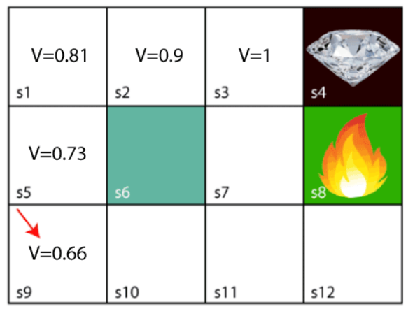
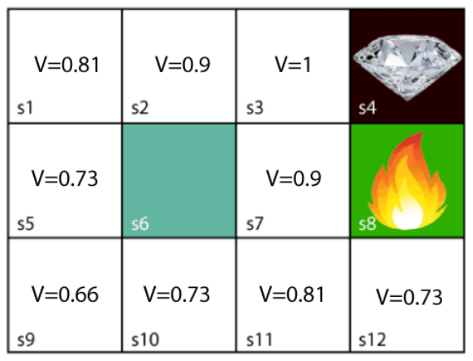
V(s) = max [R(s,a) + γV(s’)]
s4, s8 = 0
Lets assume γ = 0.9
s3: 1 + 0.9x0 = 1
s2: 0 + 0.9x1 = 0.9
s1 = 0 + 0.9x0.9 = 0.81
s5 = 0 + 0.9x0.81 = 0.73
s9 = 0 + 0.9x0.73 = 0.66
s7= 0 +0.9x1 = 0.9
s11 = 0 + 0.9x0.9 = 0.81
s10 = 0 + 0.9x0.81 = 0.73
s12 = 0 + 0.9x0.81 = 0.73

Slide 10
Thank You!

